Slide 1
Brushless Motor Circuit
Electric Drive Design

Slide 2
Brushless Motor

Slide 3
BLDC with Hall Sensors -- Topology
Typical Circuit Block Diagram
  Hall Sensors detect the position
  Over current protection and control via ADC
Notes:
This is a typical configuration for an inverter driving a BLDC using Hall Sensors.
We have the three Hall Sensors at the motor which deliver the position signal to the micro
We have the six output pattern from the micro to a driving IC, which is necessary to turn on and off the powerswitches (IGBTs or MOSFETs)
And we need at least an overcurrent protection which can be feed back to the micros hardware switchoff signal (CTRAP) and also can be used to measure the curren in the DC-link with an ADC

Slide 4
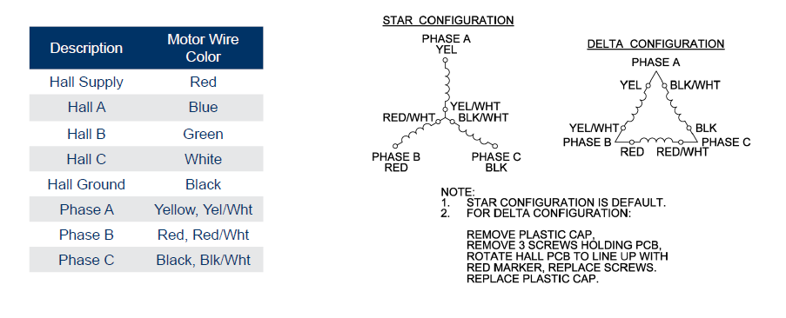
Wiring

Slide 5
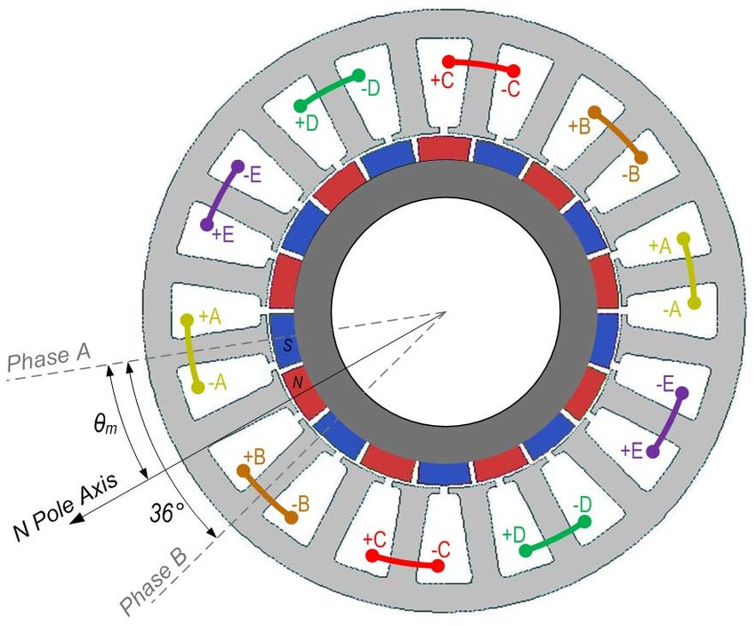
Structure and windings arrangement of the 5-phase PM BLDC motor.

Slide 6
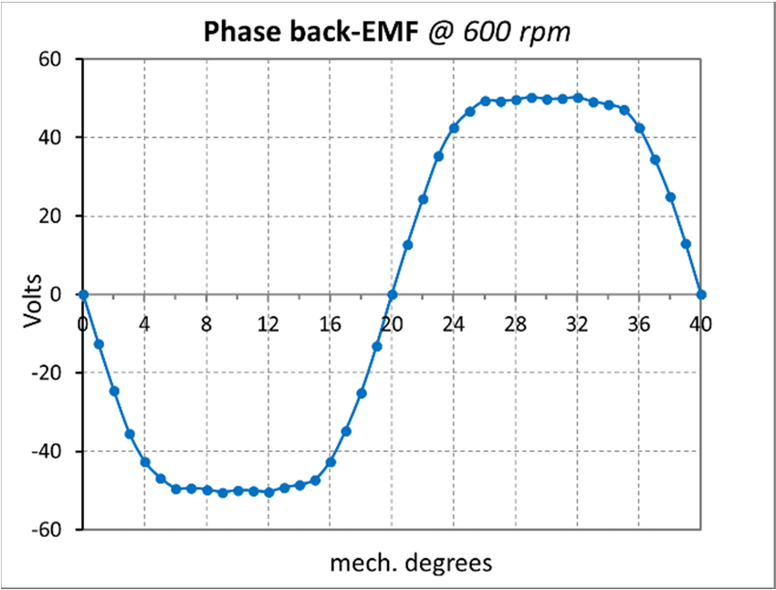
f.e.m. inducida por fase

Slide 7
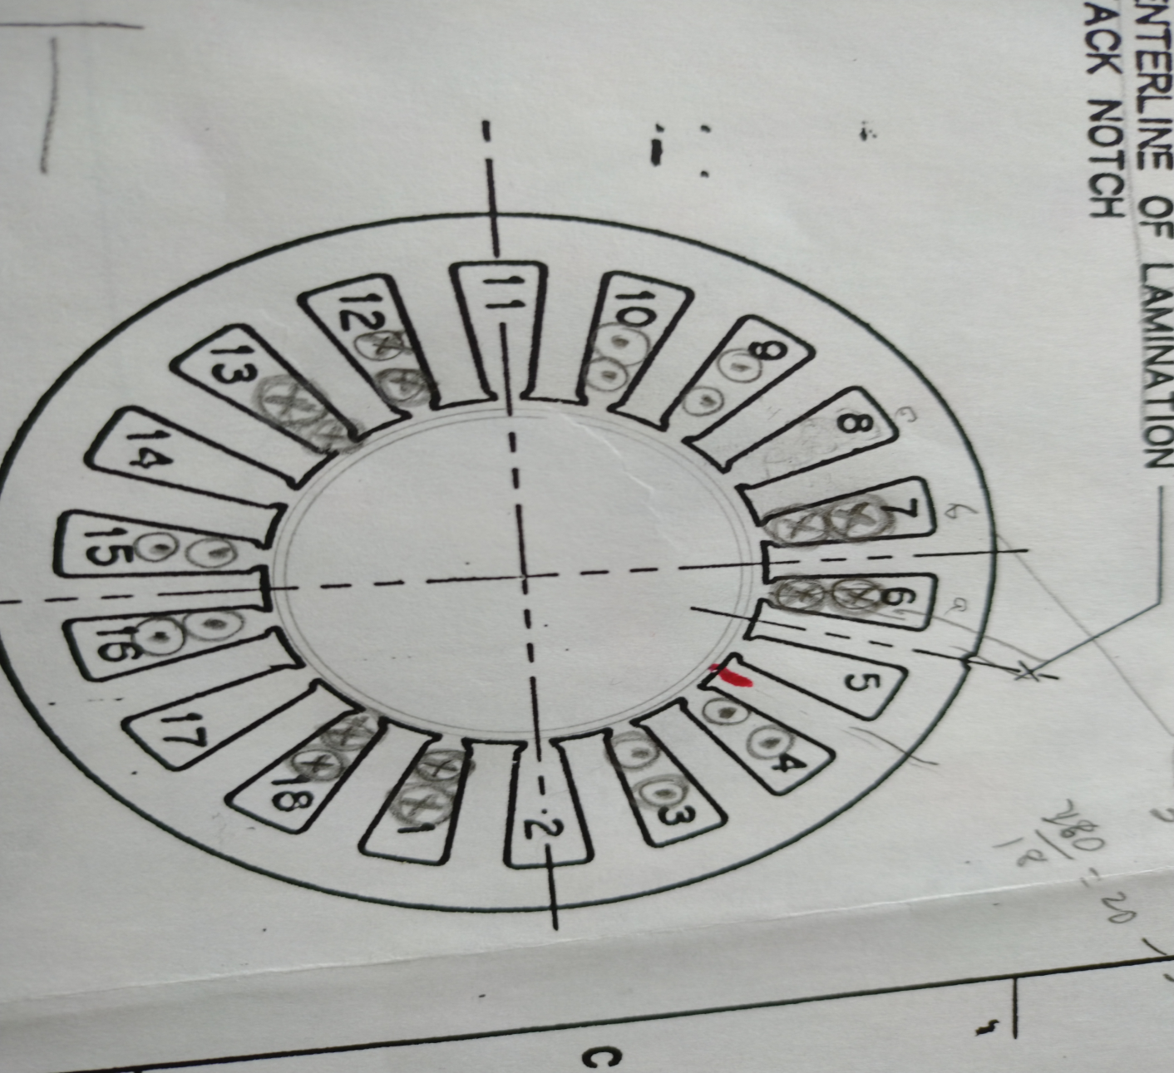
Corrientes en los devanados de un motor BLDC

Slide 8
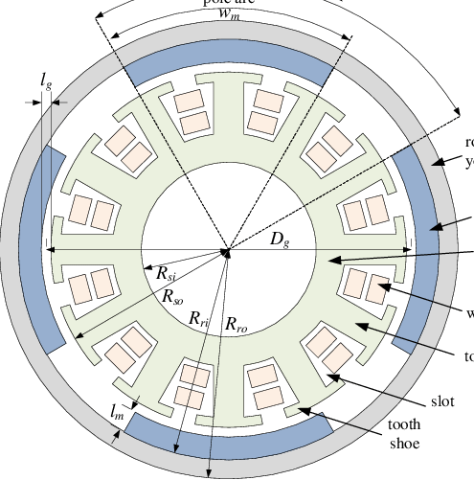
BLDC motor outside rotor

Slide 9
Switching Table for 120º Hall Spacing
Clockwise Motion
Counter-clockwise Motion

Slide 10
i_{a}
φ
c
φ
c
i_{c}
φ
φ
a
a
φ
b
φ
b
i_{b}

Slide 11
Step 1
φ
c
φ
a
φ
φ
a
b
φ
-φ
g
c

Slide 12
Step 2
φ
c
φ
a
φ
b
-φ
φ
c
b
φ
g

Slide 13
Step 3
φ
c
φ
a
-φ
φ
a
b
φ
b
φ
g

Slide 14
Step 1: With Rotor Magnet
φ
a
φ
m
Force
-φ
c
φ
g

Slide 15
Step 2: With Rotor Magnet
-φ
φ
c
b
φ
m
Force
φ
g

Slide 16
Step 3: With Rotor Magnet
-φ
a
m
φ
φ
φ
Force
g
b

Slide 17
Power Circuit

Slide 18
Step 1: Activated Transistors

Slide 19
Step 2: Activated Transistors

Slide 20
Step 6: Activated Transistors

Slide 21
Switching Signals

Slide 22

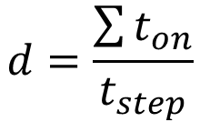
Voltage Regulation - Fixed Width Modulation
$$Without modullation, the voltage during t_{step} is{ V}_{dc}$$
$$With Modulation,{ V}_{ave}=V_{dc} d$$
$$d=\frac{\sum{t_{on}}}{t_{step}}$$

Slide 23

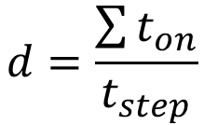
Voltage Regulation - Fixed Width Modulation
$$Without modullation, the voltage during t_{step} is{ V}_{dc}$$
$$With Modulation, phase voltage{ V}_{rms}=\frac{\sqrt{2d}}{3} V_{dc}$$
$$d=\frac{\sum{t_{on}}}{t_{step}}$$

Slide 24
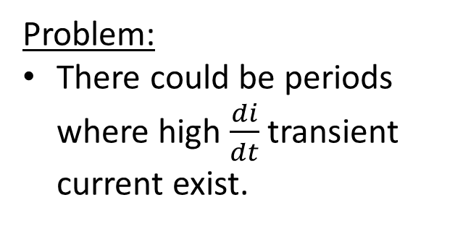
Problem
Facts:
Transistors do not immediately commutate (open)
Transistors do not immediately close
Problem:
There could be periods where high $\frac{di}{dt}$ transient current exist.

Slide 25
Solution
Make before break

Slide 26
BLDC in Theory – Back Electro Magnetic Force
Theory
  U_{P} = (R x i) + (L x di/dt) + e_{P}
  where
        "U_{P}" stands for phase voltage
        "R" stands for winding resistance
        "i" stands for actual phase current
        "L" stands for phase inductance
        "di/dt" stands for changment of phase current over time
        "e_{P}" stands for electromagnetic voltage caused by magnet
  while
  i = 0 and di/dt = 0:
  U_{P} = e_{P}
  by measuring U_{P}
  a position detection
  is possible
Notes:
To understand how this technique works, we have to understand a bit the theory of a BLDC
If we just turn the motor and watch at the phase voltage – generator mode – we will see a sinesoidal or trapezoidal voltage. This voltage is generated by a magnet which is turned through a coil – everybody knows this from school.
This voltage is called Back Electro Magnetic Force.
If we turn the motor, the BEMF-voltage must change from a positive value to a negative value. So this voltage voltage indicates the position of the Rotor-Magnet. If we are able to measure this voltage, we have the position.
Unfortunately we have to use the motor not in generator mode but in motor mode, so there are some other values which have to be taken into account.
So the phase voltage consists of following parts:
There is an ohmic part because the motor coil has some resistance, so the phase current which flows through the phase resistance will generate a voltage. These are pure losses in the coil.
The other part of the voltage comes from the inductance and the change of the current over time (di by dt)
The last part comes from the BEMF-voltage.
The trick to detect this BEMF-voltage is very easy. If the phase current is zero the part which generates the phase voltage is just the BEMF-voltage itself.
So if we have no current in one phase we can detect the zero-crossing of the BEMF and we get the position.
Ideally this zero crossing event comes 30° (electrical) before the switching event. So if we detect the zero crossing we need a phase delay of about 30°and perform then the next switching state.
To summarize, the BEMF-zero crossing technique can replace the hallsensor but there are some difficulties:
This does not work at standstill and low speed, as the BEMF-signal is to low
The BEMF-voltage and shape strongly depends on construction and type of the motor

Slide 27
Dynamic Braking
Method 1:
Open all top transistors
Close and regulate all lower transistors

Slide 28
Dynamic Braking
Method 2:
Open all transistors
Close and regulate the triacs

