Slide 1
Generator For Cycloid Movement The difference between cycloid gears and high ratio magnetic gears is the different type of output gears. The generator for cycloid movement has the same principal.

Slide 2
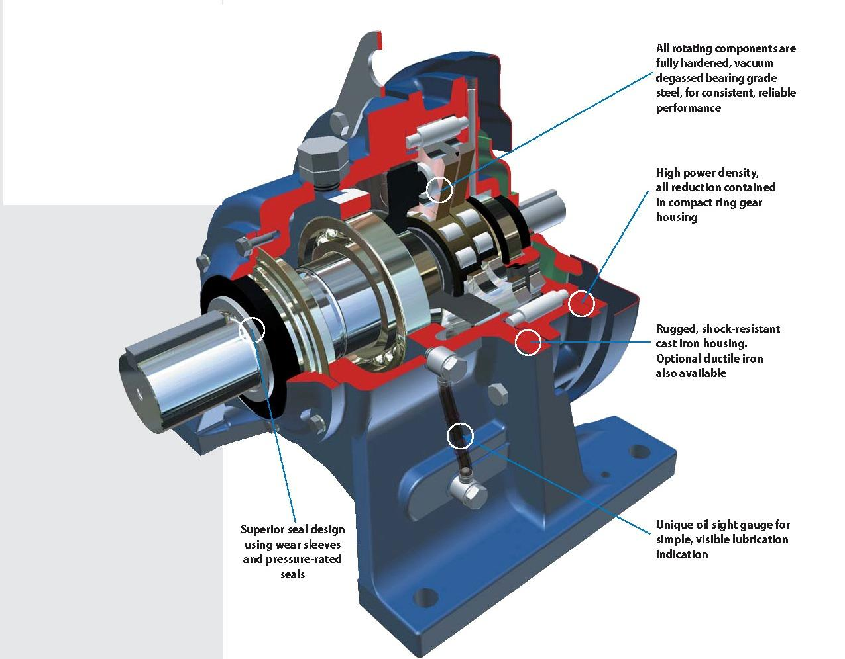
CYCLOID GEARS

Slide 3
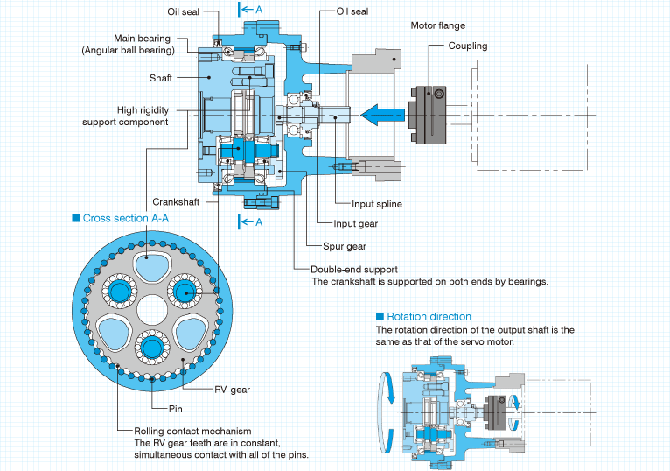
Features and Configurations

Slide 4
Principle of Operation
Rotation of the servo motor is transmitted through to the crankshafts
Two gears are mounted around the needle bearings on the eccentric region of the crankshaft. (In order to balance the equal amount of force, two gears are mounted).
When the crankshafts rotate, the two gears mounted on the eccentric sections also revolve eccentrically around the input axis (crank movement)
Pins are arrayed in a constant pitch in the grooves inside the case. The number of pins is just one larger than the number of teeth.
As the crankshafts revolve one complete rotation, the gears revolve eccentrically one pitch of a pin (crank movement), with all the RV teeth in contact with all of the pins.
The rotation is then output to the shaft (output shaft) via the crankshaft so that the crankshaft rotation speed can be reduced in proportion to the number of pins.

Slide 5
Reduction Movements

Slide 6
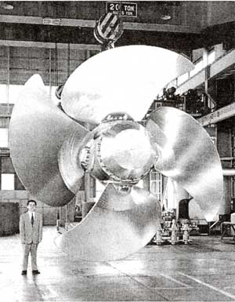
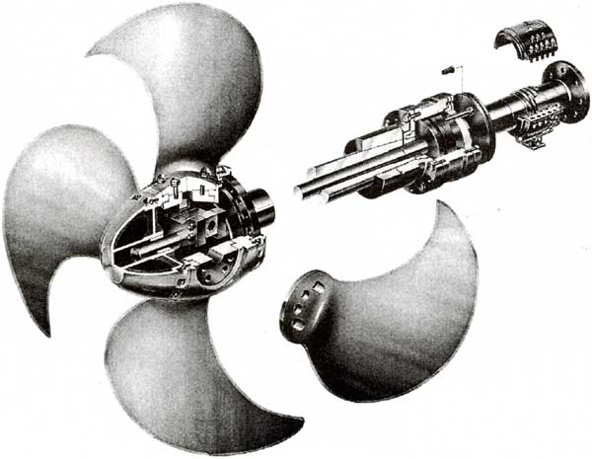
Kamome Controllable Pitch Propeller
Pitch propeller is using outfitting concentric type reduction gear to operate propeller

Slide 7
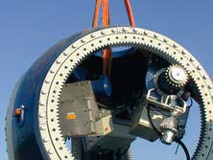
Sumitomo Cyclo Drive FOR Wind Turbines

